Slide 1

Prototype to production.
With you all the way.
Notes:
Now we’re going to learn how Windows 10 IoT provides value at every step along the journey of creating and running an IoT solution

Slide 2
Windows IoT Core Labs Part 2: Tools Needed (Quick Start)
Presenter Name
Title
Contact Info

Slide 3

Windows IoT Core
Hands on Lab
2. Tools Needed (Quick Start)
 Event Code MSFTEVENT XXXXX  WiFi MSFT GUEST
Notes:
Hi, I’m ___, and I’m excited to discuss Windows IoT Core, and the value it can deliver to your organization.
Pick one of these 2 slides

Slide 4

Windows IoT Core
Hands on Lab
2. Tools Needed (Quick Start)
 Event Code MSFTEVENT XXXXX  WiFi MSFT GUEST
Notes:
Hi, I’m ___, and I’m excited to discuss Windows IoT Core, and the value it can deliver to your organization.
Pick one of these 2 slides

Slide 5
Logistics
 Month 00, 20xx
X day(s) event
 8:00AM – 5:00PM
🍔 12:00PM – 1:00PM
Lunch Room Around the Corner
🚻 On the left down the hallway
 Event Code MSFTEVENT XXXXX  WiFi MSFT GUEST

Slide 6
Windows IoT Core.
Quick Start
Notes:
Now we’re going to learn how Windows 10 IoT provides value at every step along the journey of creating and running an IoT solution

Slide 7
Topics Covered
Device Types
Tools Needed
First Image
First Deploy
UWP Apps (and debug)

Slide 8




Device Types
ARM
x86
x64

Slide 9
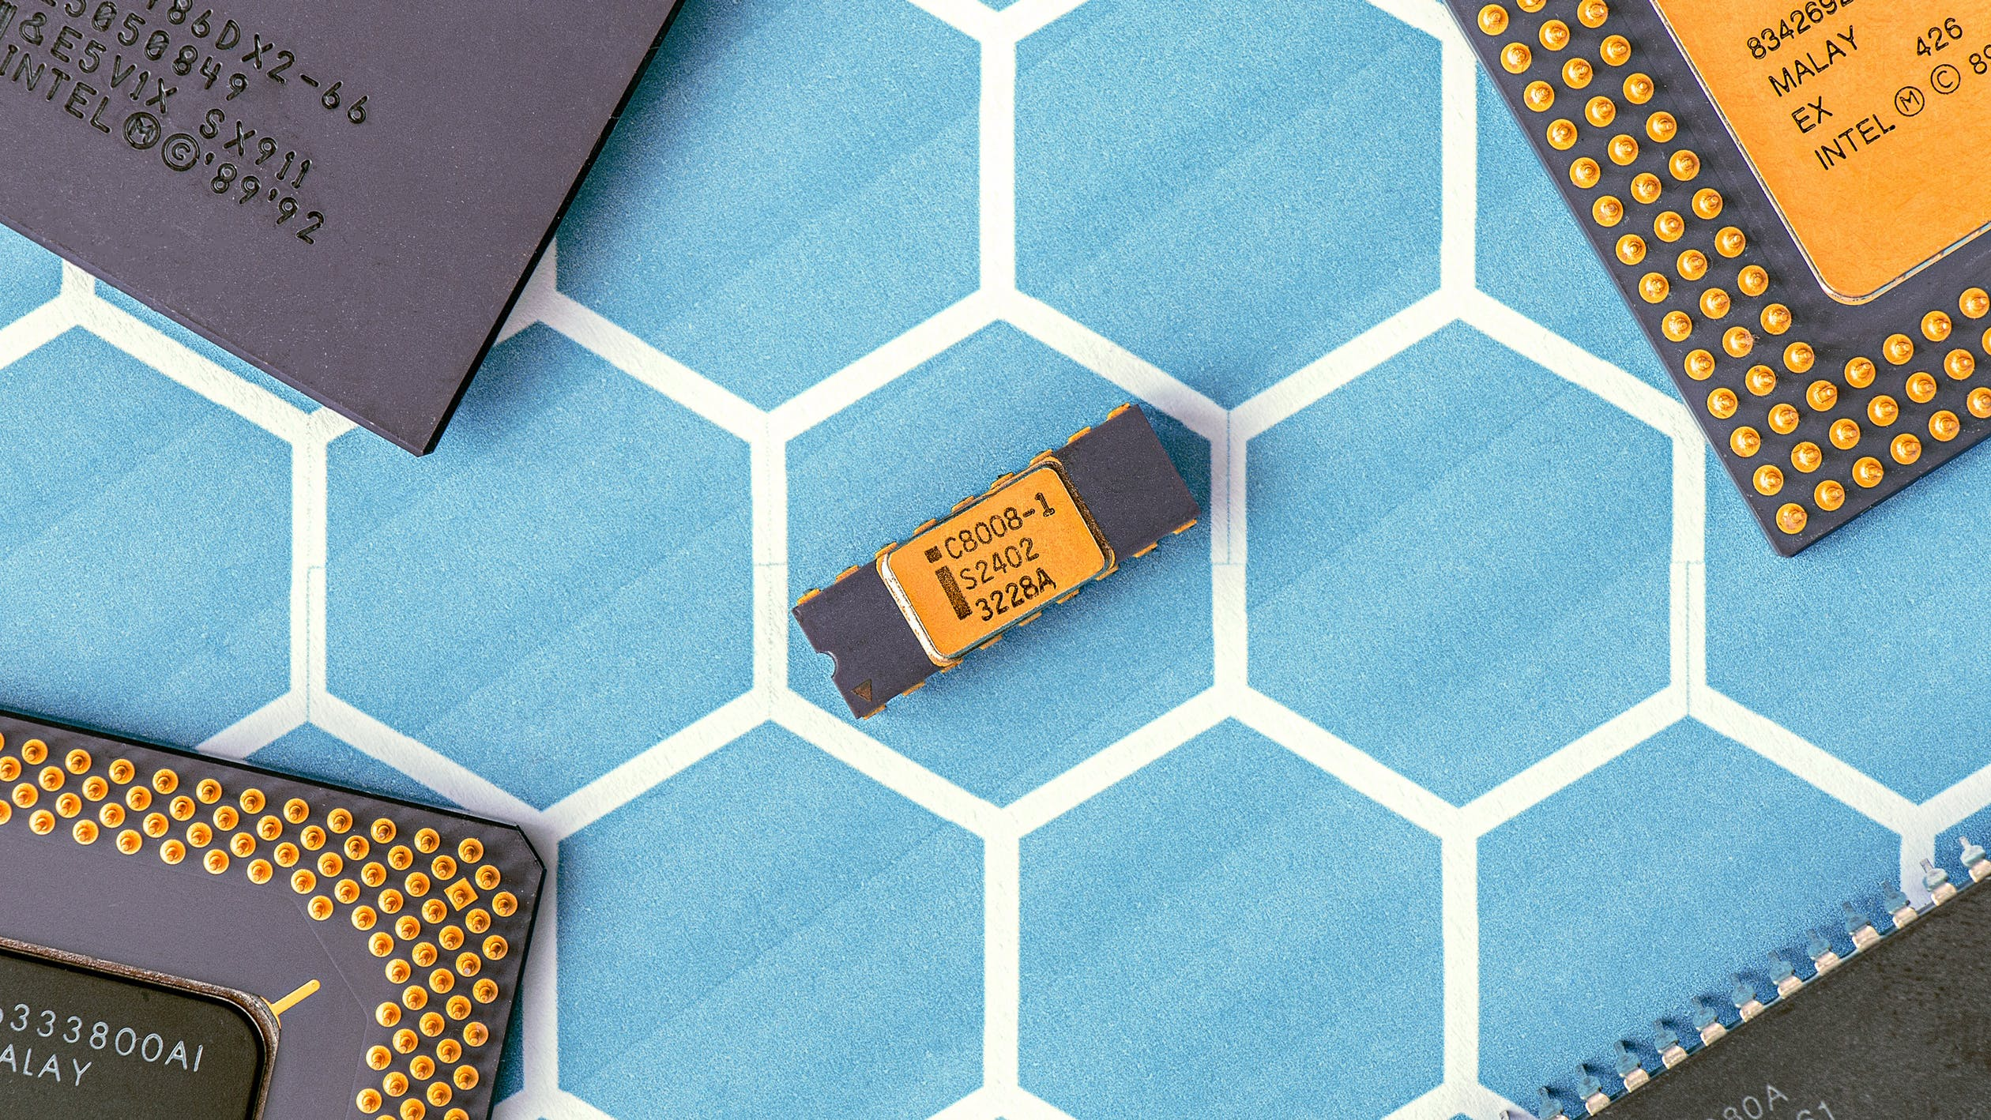
Sky is the limit as long as you have BSPs

Slide 10

Board Support Packages (BSPs)

Slide 11










What’s in the sauce?
Windows IoT Packages
Security Settings
IoT Core Test Image(s)
Board Support Packages
Custom Driver(s)
IoT Core Retail Image(s)
Custom App(s)

Slide 12
Tools Needed

Slide 13




Tools Needed
Technician PC with 15GB free Space
IoT Device
Windows Software Packages http://aka.ms/
SD Card
HDMI Cable

Slide 14



Tools Needed
Windows Assessment & Deployment Kit http://aka.ms/adk
Windows IoT Core Dashboard http://aka.ms/
Windows PE add-on for ADK http://aka.ms/
EV Code Signing Certificate http://aka.ms/
Windows Driver Kit http://aka.ms/
Visual Studio Code http://aka.ms/
Windows IoT Core Packages http://aka.ms/
Visual Studio 2017 (or newer) http://aka.ms/

Slide 15



First Image
Download Image http://aka.ms/
Install Image Use IoT Core Dashboard
Boot it up

Slide 16
Deploying and Testing UWP apps

Slide 17

© 2016 Microsoft Corporation. All rights reserved.
Notes:
Thanks for your time.

